Slide 1
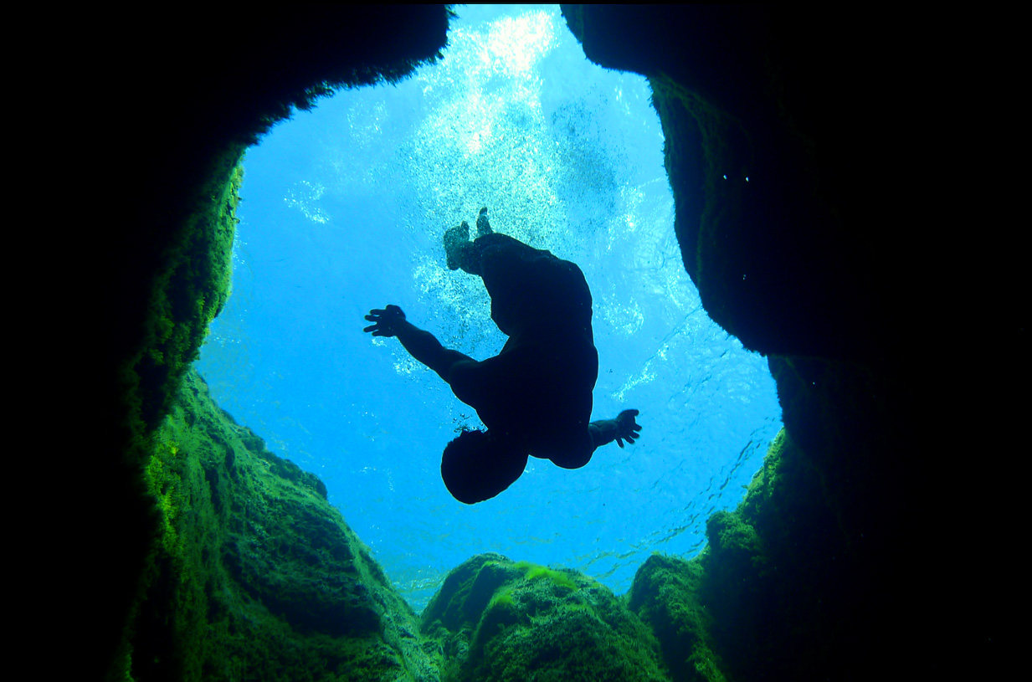
Groundwater Management Tools
Charlie Flatten
Hays Trinity Groundwater Conservation District
GM@HaysGroundwater.com

Slide 4
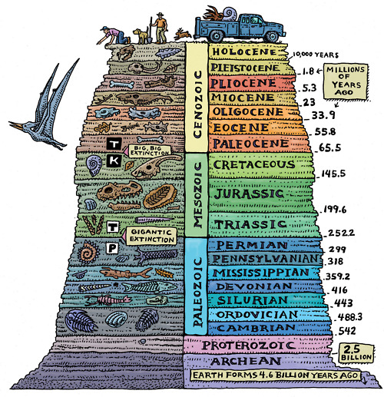
Geology
Notes:
Lets talk geology. Lots of forces at work:
Deposition: volcanic ash, and lava, sediments
Uplift
Erosion

Slide 5
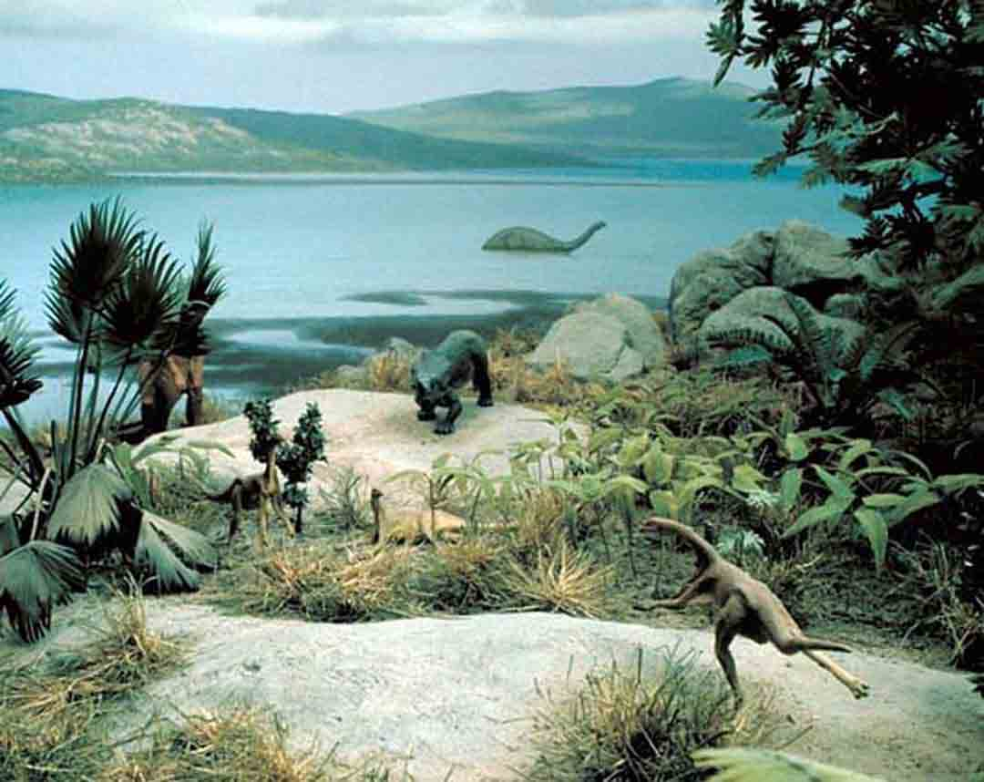
Notes:
100 or so million years ago the hill country wasn’t hilly at all. In fact, it was mostly some part of a large inland sea.

Slide 6
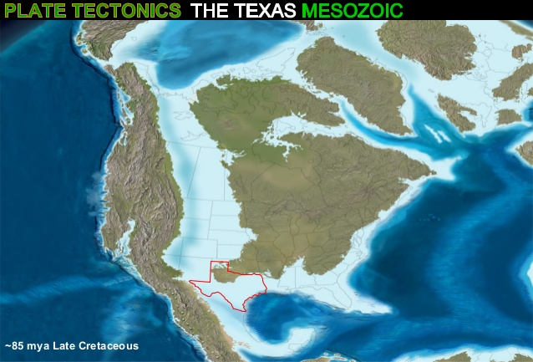
~ 100 Million Years Ago
Notes:
As seas do, ours receded and grew. Over time sediments from that seas marine life built up massive layers of what became limestone and our current aquifers.

Slide 7
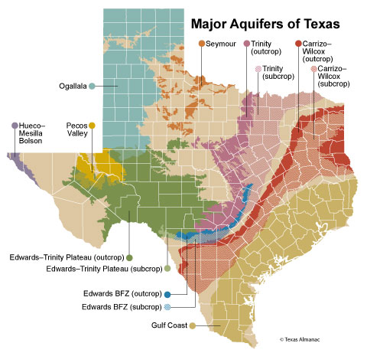

Slide 8
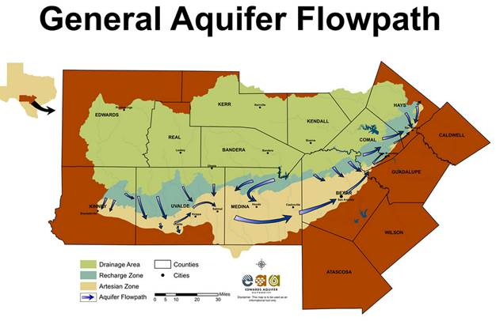
Notes:
The green is the drainage area
The blue is the recharge zone
The tan is the confined/artesian zone
And below in the brown, is the brackish zone (just south of san Antonio, 1 mile deep and 3x the salinity of ocean water.

Slide 9
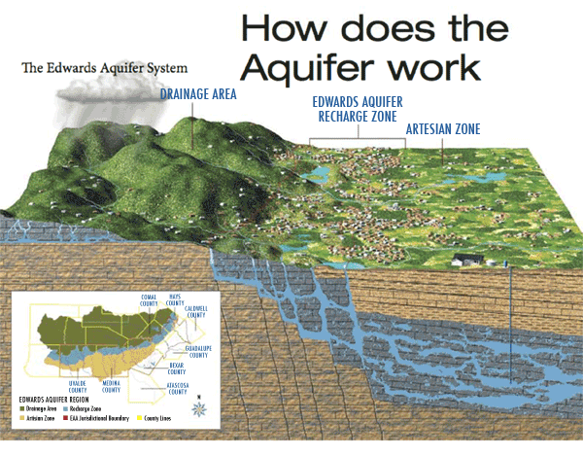
© EAA

Slide 10
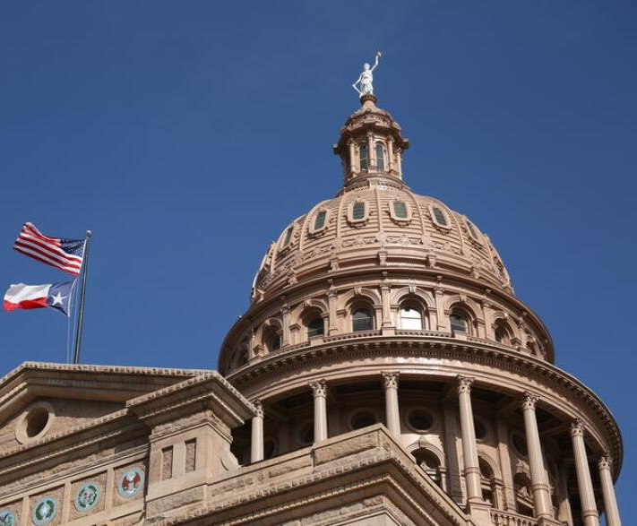
Chapter 36 of the Texas Administrative Code + HTGCD Enabling Legislation = District Toolbox

Slide 11
Sound Data results in Sturdy Science and makes Good Policy

Slide 12
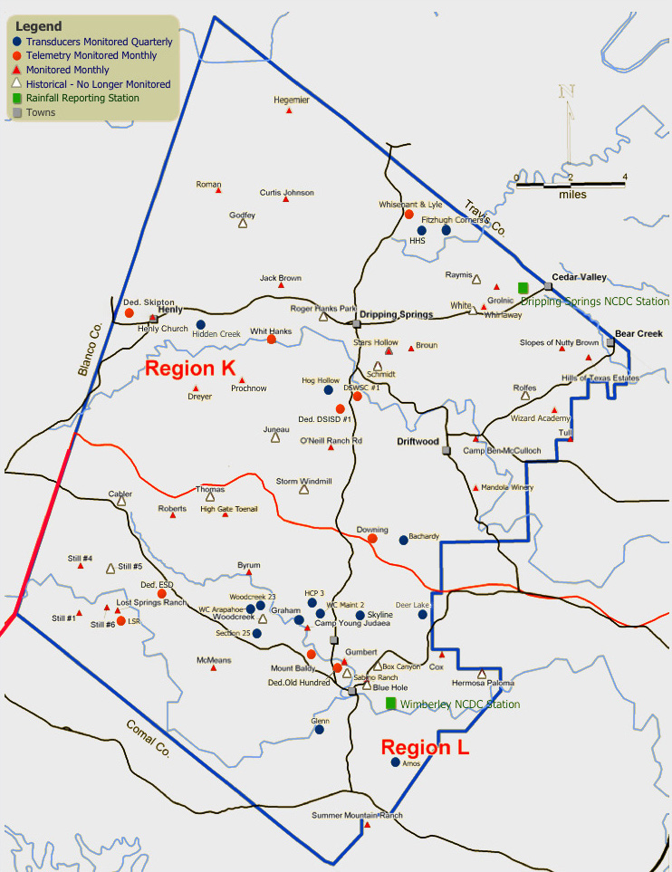
Data Management Well Registration Utility Connections Monitor Wells Springflow Water Quality Mass Balance (in -v- out)

Slide 13
Aquifer Science Mapping Springs Karst Recharge Stratigraphy Depletion Zone Sample & Test Flow Paths & Rates GW – SW interaction

Slide 14
Aquifer Protection Permitting Rules and Law Drought Management Waste Prevention Pollution Prevention Long-range planning

Slide 15
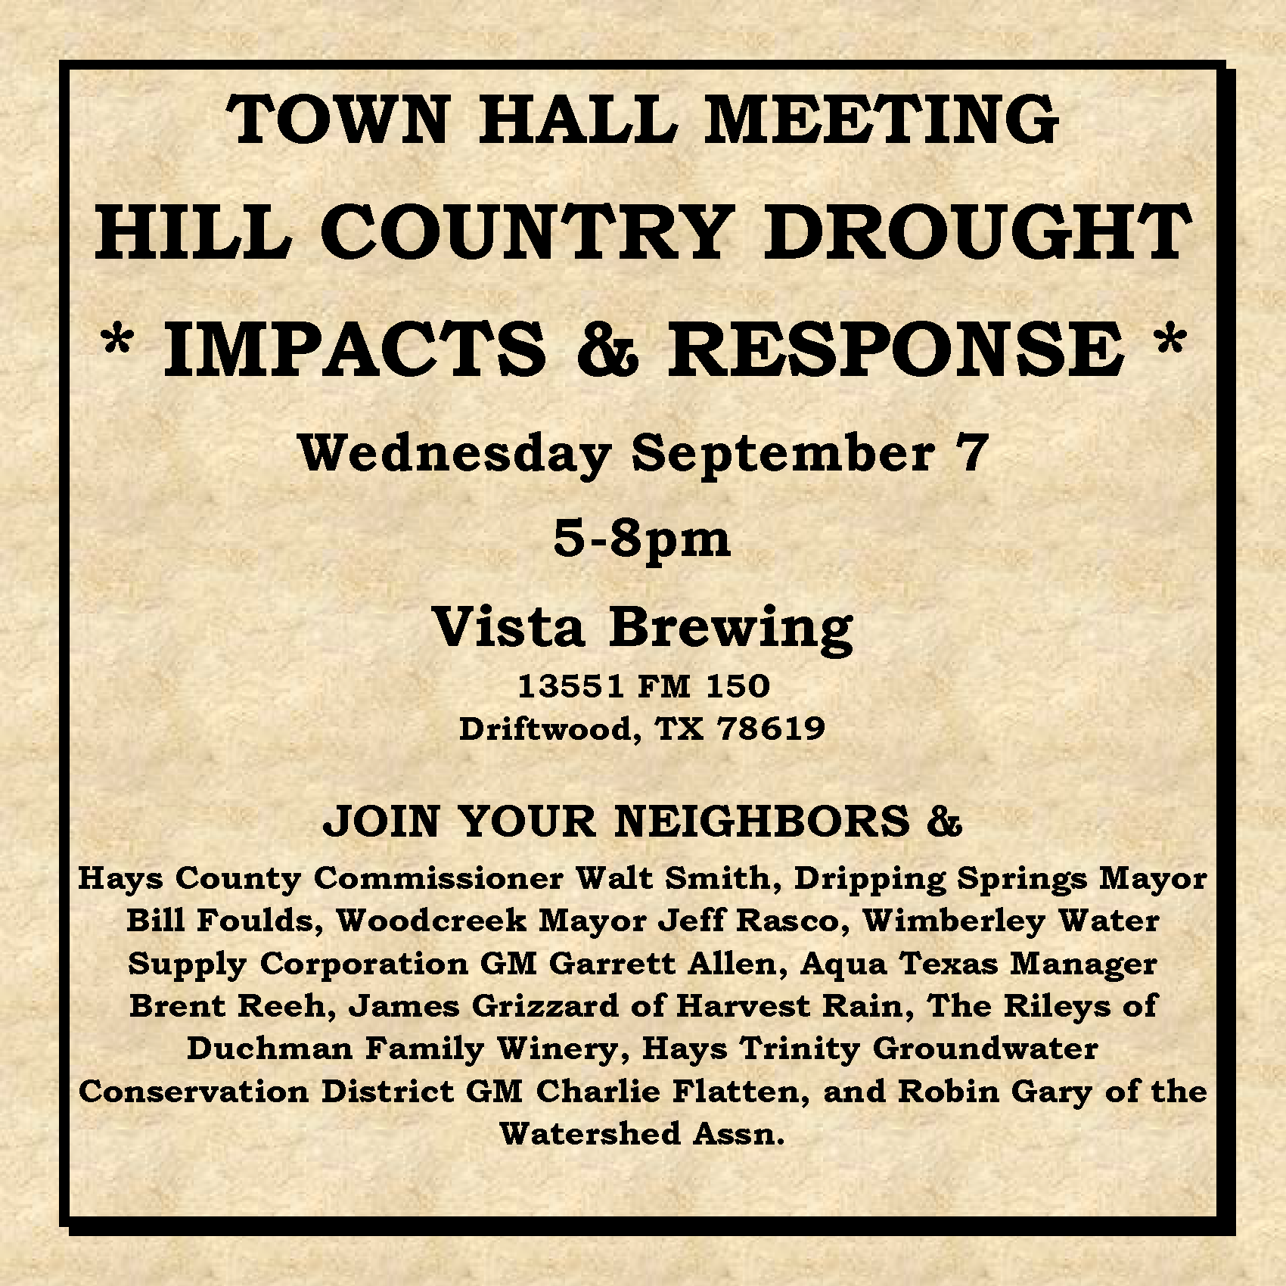
Information & Outreach Panels/Presentations BMPs Conservation Alternate supplies Contamination Alerts Drilling data Well data

Slide 16
107 Neighbors + Beer = Lively Q & A

Slide 17
Quarterly Speakers + Board Meetings = Lively Q & A

Slide 18
Access to Statewide Law making & Long-Range Planning State Water Plan Aquifer Wide Planning Watershed Planning Regional Flood Planning Legislative process

Slide 19
127 Neighbors + Wimberley = Lively Q & A

Slide 20
Relationships Hays County Neighboring GCDs TCEQ TWDB Local Cities Local Utilities NGOs Legislature Well Drillers Well Owners

Slide 21
Management Tools at Work Need Plan Data Research Development Stakeholders Compromise New Rules Education Common Goal

Slide 22
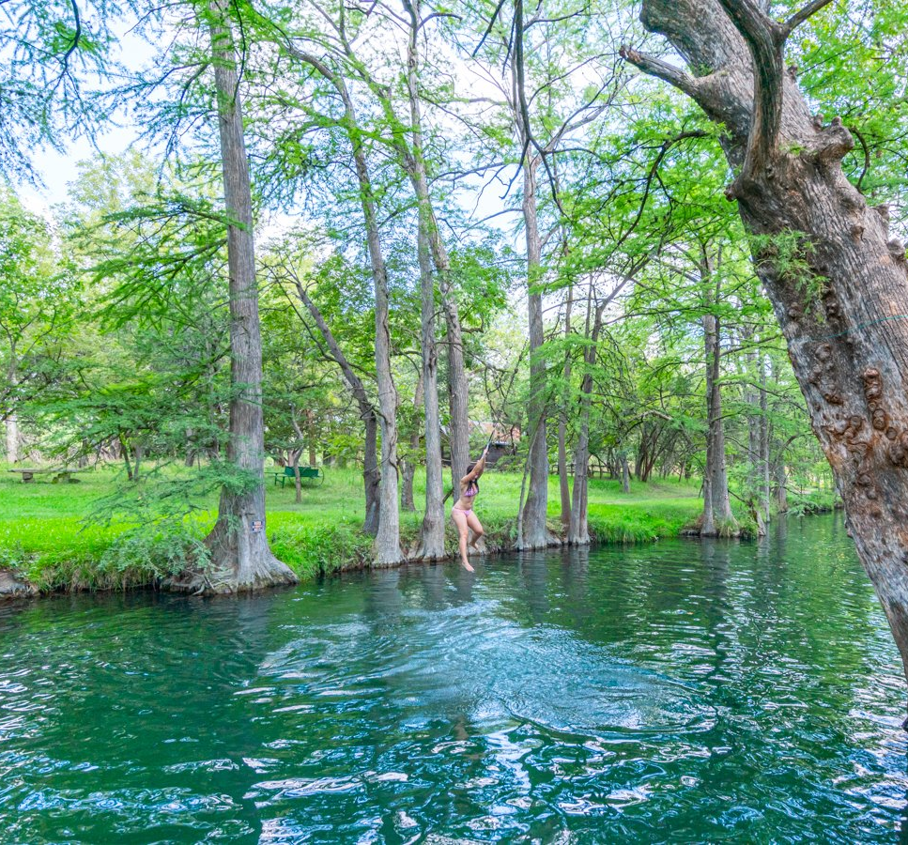
Management Tools at Work Need Plan Data Research Development Stakeholders Compromise New Rules Education Common Goal

Slide 23
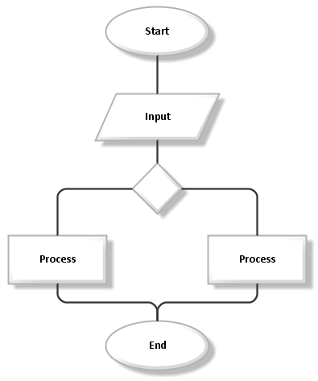
Management Tools at Work Need Plan Data Research Development Stakeholders Compromise New Rules Education Common Goal

Slide 24
Management Tools at Work Need Plan Data Research Development Stakeholders Compromise New Rules Education Common Goal

Slide 25
Management Tools at Work Need Plan Data Research Development Stakeholders Compromise New Rules Education Common Goal

Slide 26
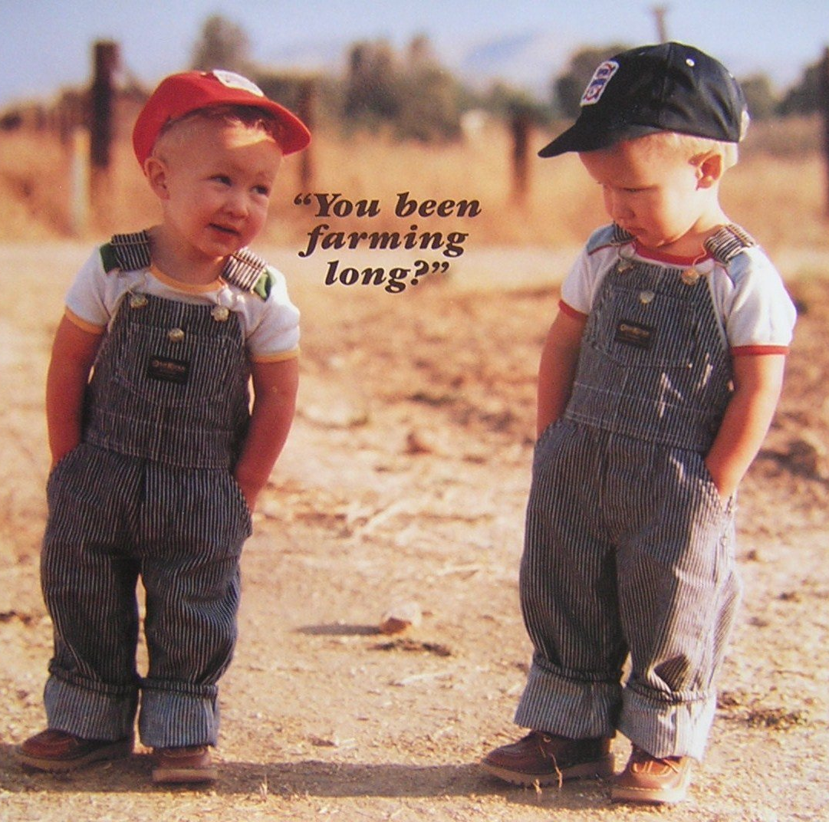
Management Tools at Work Need Plan Data Research Development Stakeholders Compromise New Rules Education Common Goal

Slide 27
Management Tools at Work Need Plan Data Research Development Stakeholders Compromise New Rules Education Common Goal

Slide 28
Management Tools at Work Need Plan Data Research Development Stakeholders Compromise New Rules Education Common Goal

Slide 29
Management Tools at Work Need Plan Data Research Development Stakeholders Compromise New Rules Education Common Goal

Slide 30
Management Tools at Work Need Plan Data Research Development Stakeholders Compromise New Rules Education Common Goal

Slide 31
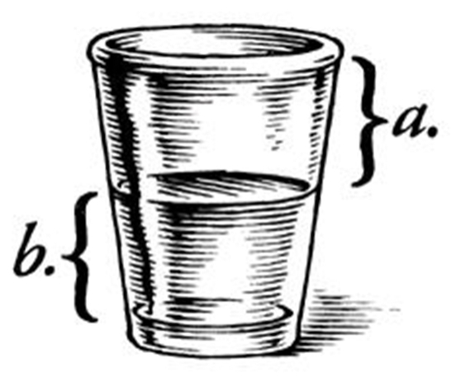
The cheapest new water… is the water that we already have
http://emilymullaswilson.wordpress.com/2012/10/18/the-joy-of-the-half-empty-glass/
Notes:
The cheapest water that we can buy is the water that we already have but waste or misuse.

